Slide 1



PURPOSE OF THE PRESENTATION
Showcase the project that involved deploying an AD DS environment and a centralized SIEM server using Splunk.
Focus on detecting and mitigating brute force attacks within the AD DS environment.
Notes:
Good morning ladies and gentlemen. Thank you for joining us today. Today, we are here to discuss an important topic: Detecting and Mitigating Brute Force Attacks in an AD DS Environment using Splunk. The purpose of this presentation is to provide you with insights into our project, where we successfully deployed a fully featured Active Directory Domain Services (AD DS) environment and a centralized Security Information and Event Management (SIEM) server using Splunk. Our primary goal was to detect and mitigate brute force attacks within the AD DS environment effectively

Slide 2
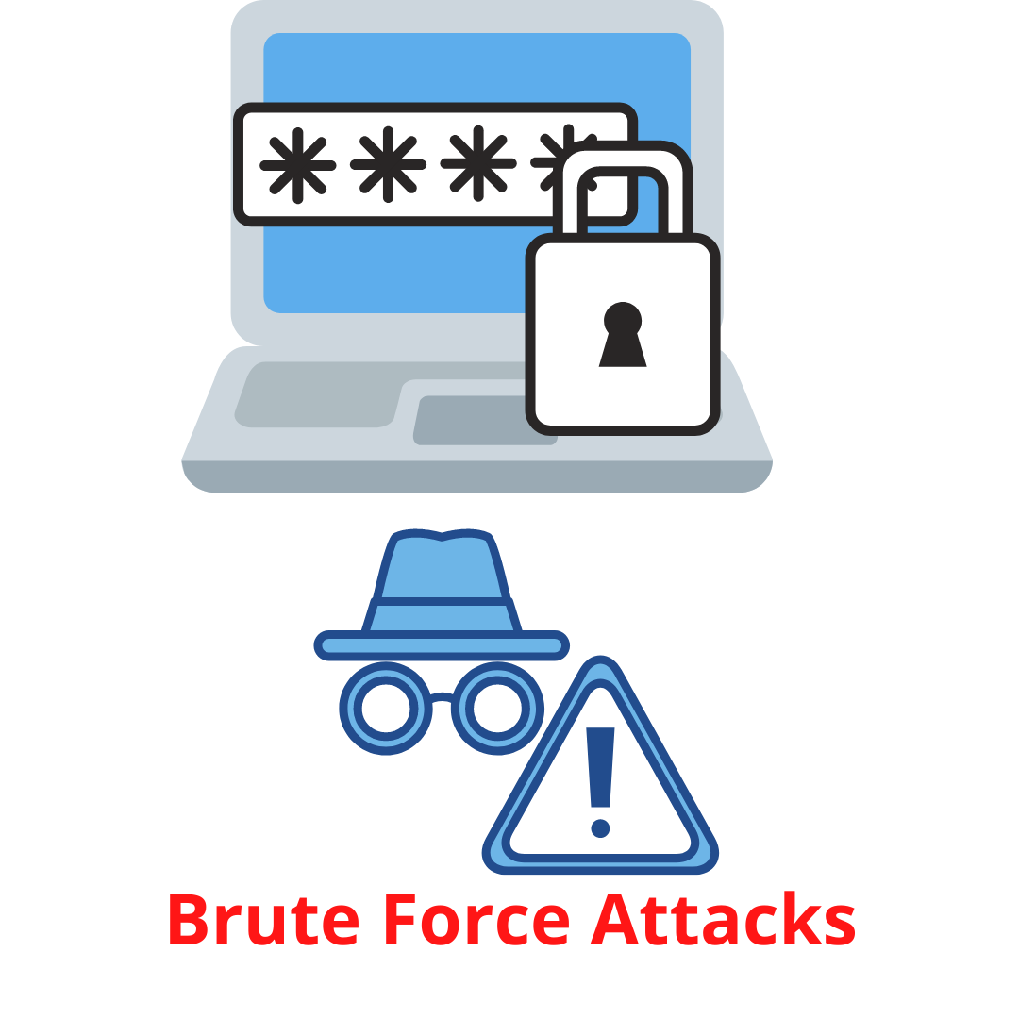

Brute Force Attacks
Brute force attacks involve repeatedly attempting different combinations of usernames and passwords to gain unauthorized access.

Slide 3


IMPACT OF BRUTE FORCE ATTACKS
Compromise user accounts: Successful brute force attacks can lead to unauthorized access to user accounts, allowing attackers to exploit sensitive information.
Data breaches: Brute force attacks can result in data breaches, exposing confidential data and potentially violating compliance regulations.
Financial and reputational damage: Organizations can suffer financial losses due to the costs associated with mitigating the attack, addressing the consequences, and potential legal repercussions. Reputational damage can harm customer trust and confidence.

Slide 4
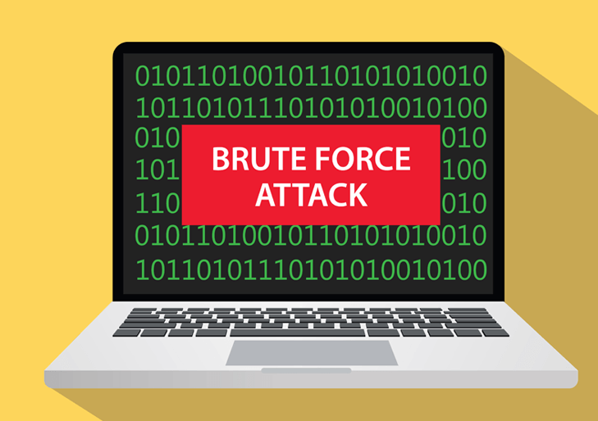
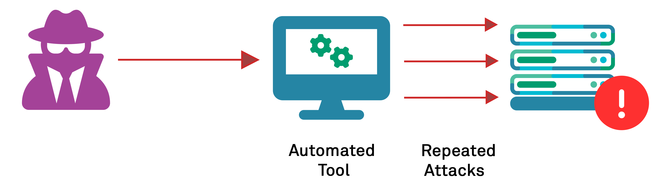
Importance of detecting and mitigating brute force attacks
Ensuring security: Detecting and mitigating these attacks is crucial to safeguard the integrity and confidentiality of our environment.
Preventing unauthorized access: By identifying and responding to brute force attacks, we can prevent unauthorized individuals from gaining access to sensitive resources.
Protecting data: Mitigating brute force attacks helps to protect sensitive data, preventing potential data breaches and safeguarding the privacy of our users.
Maintaining trust: By effectively detecting and mitigating brute force attacks, we demonstrate our commitment to security, enhancing customer trust and preserving our organization's reputation.

Slide 5


Overview of the project setup
AD DS environment: We deployed a fully featured Active Directory Domain Services (AD DS) environment to efficiently manage user accounts and passwords.
SIEM server: To enhance our security capabilities, we implemented Splunk, a robust Security Information and Event Management (SIEM) platform.

Slide 6
Key components of the environment
Active Directory server
Splunk server
SSH server
SMB server
Attacker Machine
FTP server
Notes:
Active Directory server: The AD DS server is responsible for managing user accounts, authentication, and authorization within the environment.
FTP server: We deployed an FTP server to facilitate file transfer capabilities securely.
SSH server: An SSH server was set up to enable secure remote access and administration.
SMB server: The SMB server was implemented to provide shared file and printer access within the network.
Splunk server: The Splunk server serves as our centralized SIEM platform, collecting, indexing, and analyzing logs from the environment.
Attacker machine: We included an attacker machine to simulate and demonstrate brute force attack scenarios.

Slide 7

Splunk Configuration

Slide 8
Configuration of Splunk for detecting brute force attacks
Log collection
Brute Force detection
Parsing and indexing
Alert generation
Notes:
Log collection: Splunk is configured to collect logs from various endpoints, including the Active Directory server and the targeted servers (FTP, SSH, and SMB). This ensures that relevant log data is ingested into Splunk for analysis.
Parsing and indexing: Upon ingestion, Splunk parses and indexes the logs, making them searchable and enabling efficient analysis. This process extracts key fields and structures the data for effective detection and investigation.
Brute force attack detection: Splunk is specifically configured to identify specific EventIDs associated with brute force attacks within the AD DS environment. This includes monitoring for repeated failed login attempts, account lockouts, and other relevant indicators of brute force activity.
Alert generation: To promptly notify security administrators when brute force attacks are detected, Splunk is set up to generate alerts based on predefined conditions and rules. These alerts can be customized to include relevant details, severity levels, and escalation procedures.

Slide 9


Brute Force Attack Demo
1
the attacker machine attempting to gain unauthorized access
2
Splunk actively monitors the logs and events from these servers in real-time
3
Splunk detects the brute force attacks
4
EventIDs or log patterns that indicate the presence of a brute force attack
5
generated alerts and notifications within Splunk's user interface
Notes:
the attacker machine attempting to gain unauthorized access to the FTP, SSH, and SMB servers using different combinations of usernames and passwords.
Emphasize the repetitive nature of the attack, showcasing multiple login attempts with various credentials.
Explain that Splunk actively monitors the logs and events from these servers in real-time to detect and respond to brute force attacks.
Showcase how Splunk detects the brute force attacks by correlating the EventIDs associated with these attacks.
Highlight the specific EventIDs or log patterns that indicate the presence of a brute force attack, such as multiple failed login attempts within a short time frame.
Show the generated alerts and notifications within Splunk's user interface, indicating the detection of the brute force attacks.
Highlight the details included in the alerts, such as the source IP address, targeted server, and timestamp.
Explain that these alerts enable a proactive response to mitigate the attacks, such as blocking the attacker's IP address or implementing account lockouts.

Slide 10
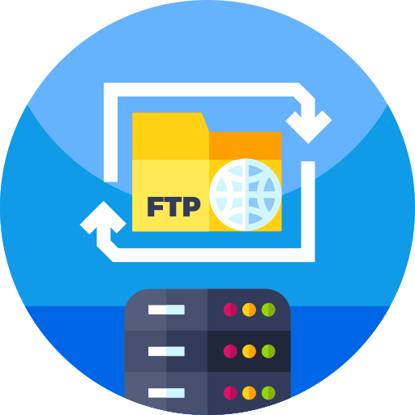

Demo
FTP Server Attack Scenario

Slide 11


FTP Server Attack Scenario
"The FTP (File Transfer Protocol) server plays a critical role in facilitating secure file transfer within our environment
FTP server attacks pose risks such as unauthorized access to confidential files and potential data breaches, which can compromise the privacy and security of sensitive data.
In our demonstration, we will simulate an attacker attempting to exploit the FTP server by launching brute force attacks or attempting unauthorized file transfers.

Slide 12
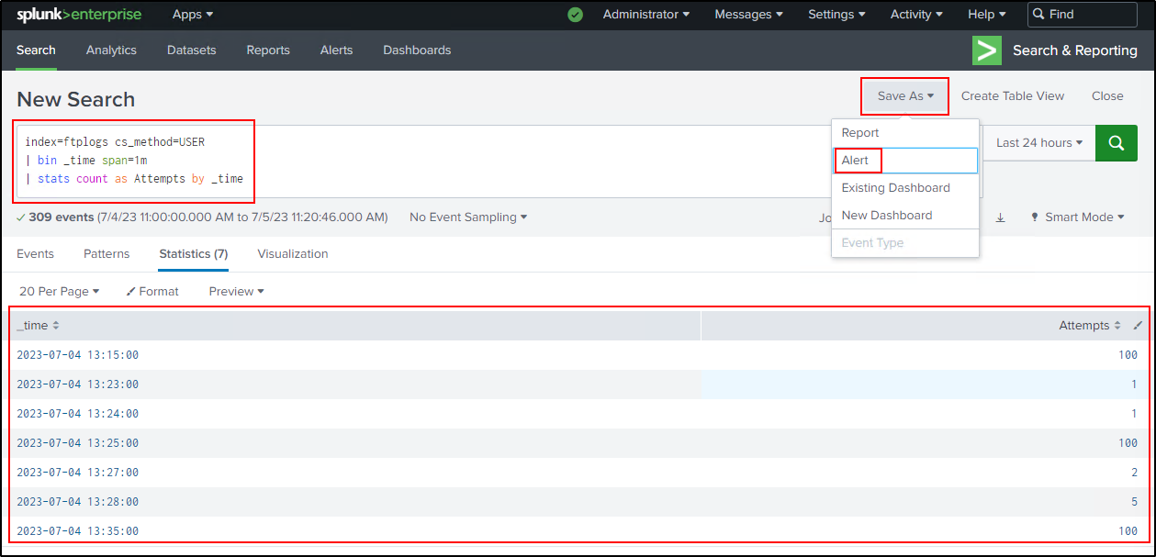

FTP Server Attack Scenario

Slide 13
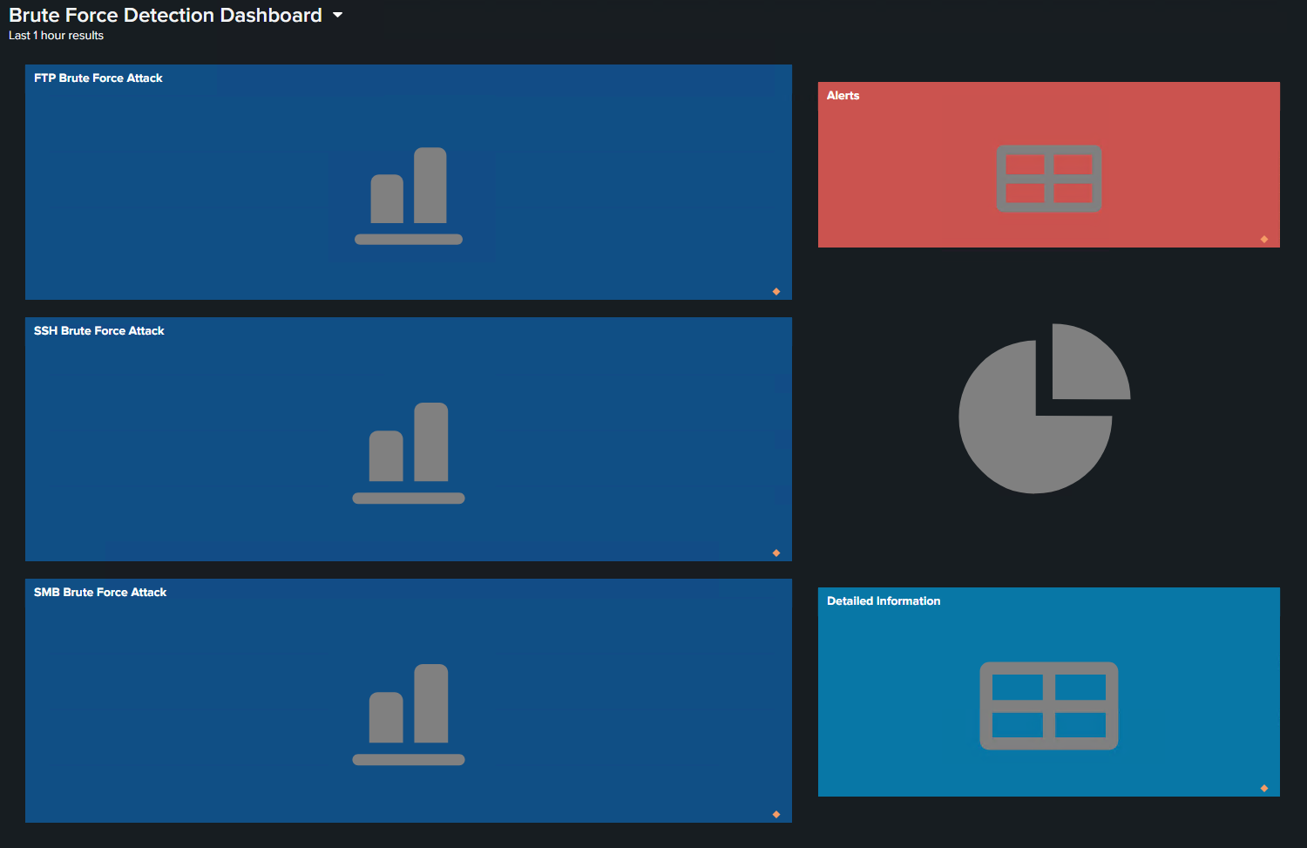
FTP Server Attack Scenario

Slide 14


Demo
SSH Attack Scenario

Slide 15

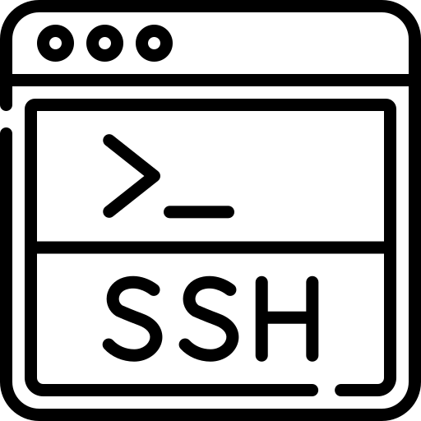
SSH Server Attack Scenario
The SSH (Secure Shell) server plays a crucial role in providing secure remote access and administration within our environment.
SSH server attacks pose significant risks, including the potential for unauthorized individuals to gain access to sensitive systems and data, leading to potential data breaches and compromised security.
In our demonstration, we will simulate an attacker attempting to brute force their way into the SSH server by repeatedly trying different username and password combinations.

Slide 16
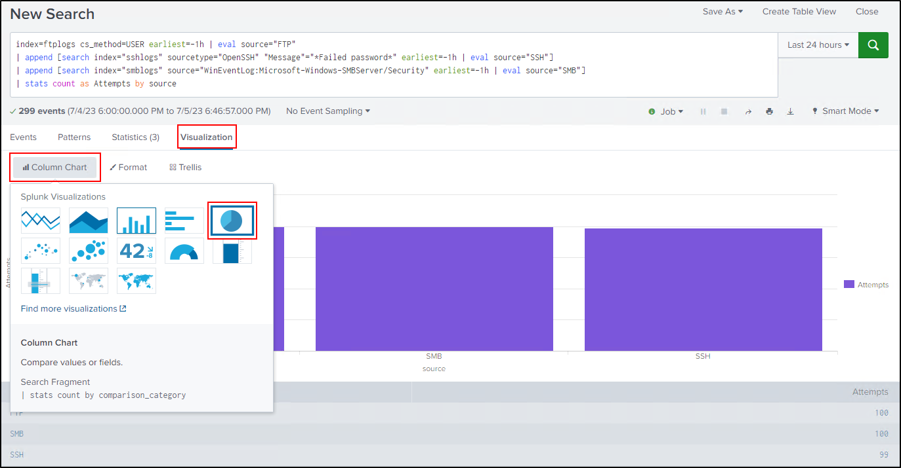
SSH Server Attack Scenario

Slide 17
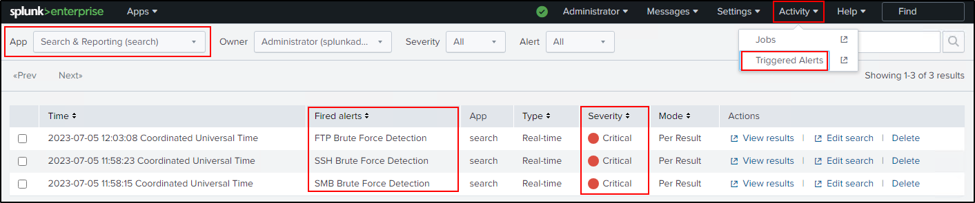
SSH Server Attack Scenario

Slide 18
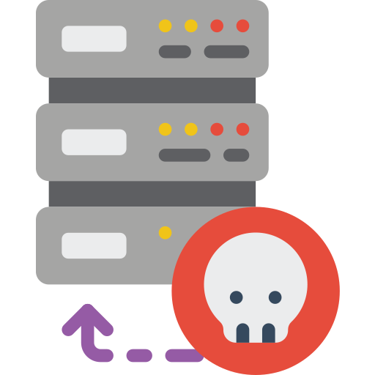

Demo
SMB Attack Scenario

Slide 19



SMB Server Attack Scenario
The SMB (Server Message Block) server is a critical component that enables shared file and printer access within our environment.
SMB server attacks pose various risks, including the potential for unauthorized access to sensitive files, data breaches, and the spread of ransomware throughout the network.
In our demonstration, we will simulate an attacker attempting to exploit the SMB server through brute force attacks or unauthorized attempts to access sensitive files.

Slide 20
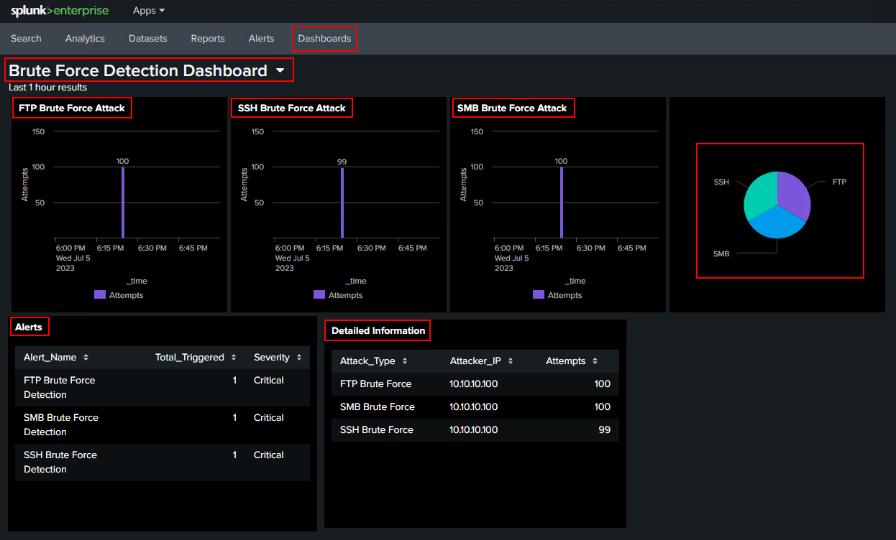
SMB Server Attack Scenario

Slide 21
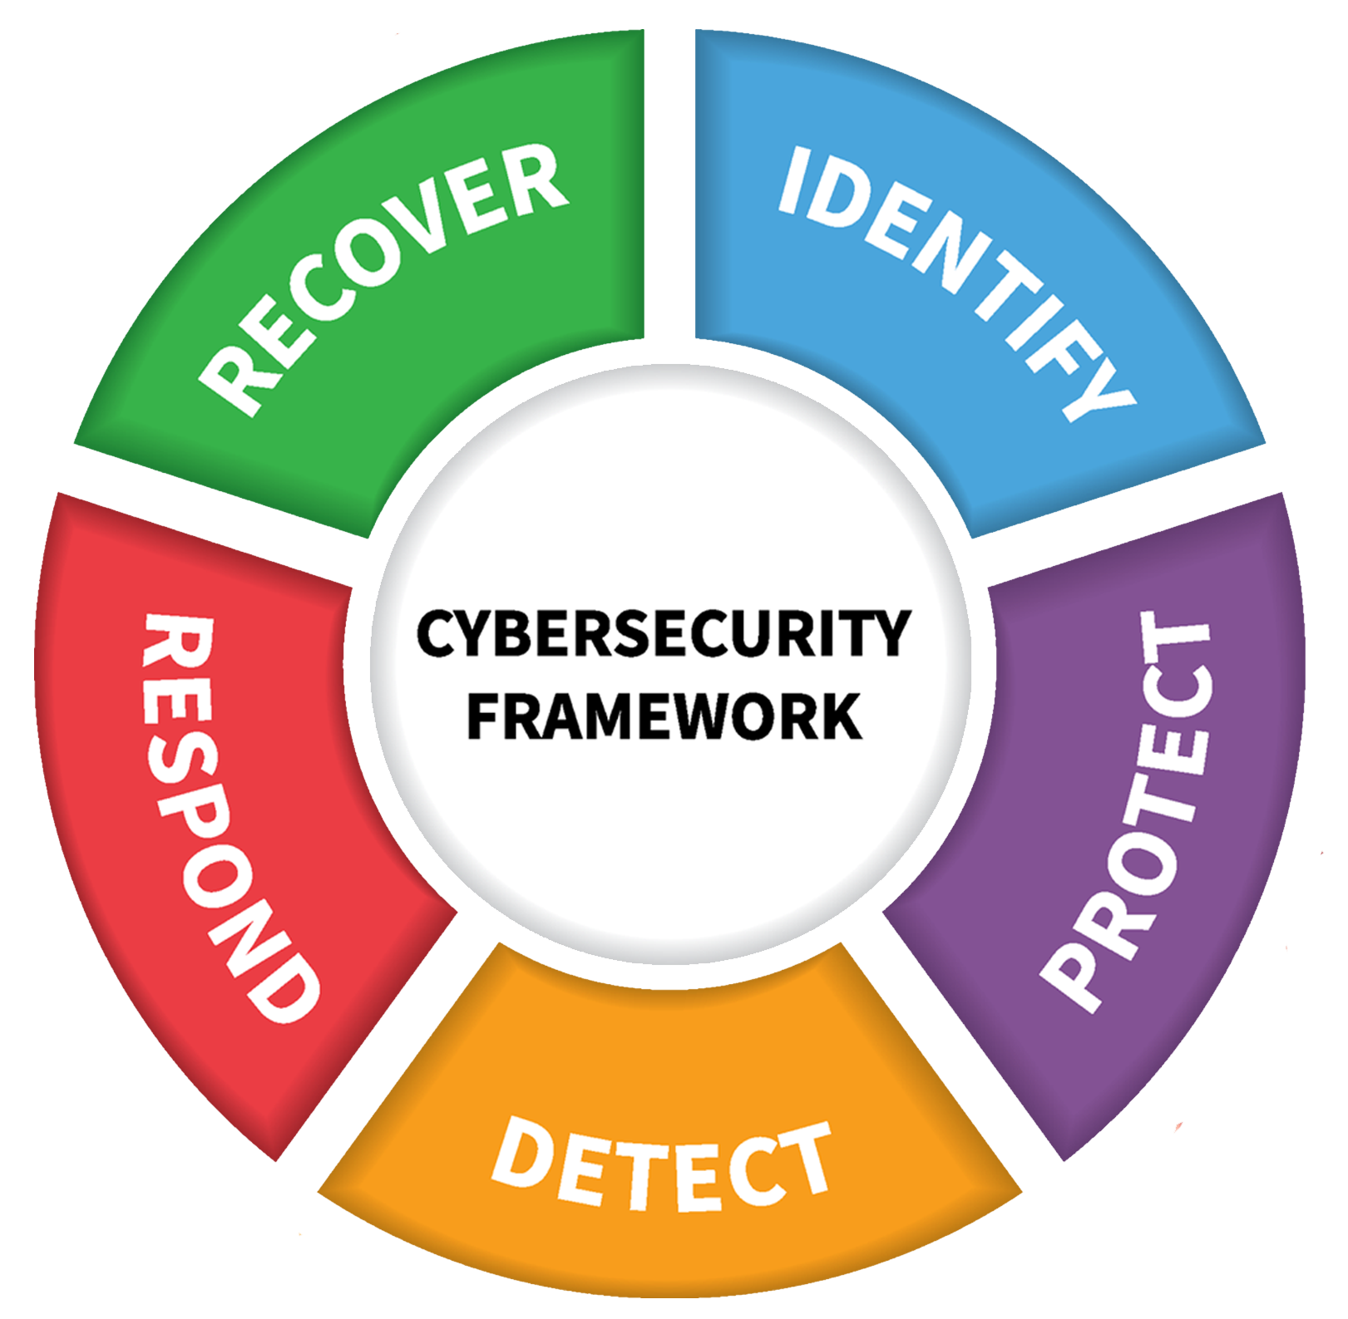



Mitigation and Response
Notes:
Mitigation and response strategies for brute force attacks include taking immediate action to block attackers, having an incident response plan, continuous monitoring, and promoting education and awareness about password security.

Slide 22
Mitigation and response strategies
Immediate action
Incident response
Continuous monitoring
Education and awareness
Notes:
Immediate action: Once a brute force attack is detected, the security team can take immediate action to block the attacker's IP address or implement account lockouts. This helps to prevent further unauthorized access attempts and minimize the impact of the attack.
Incident response: Explain the importance of having an incident response plan in place to effectively handle brute force attacks. This plan should include steps to investigate the attack, analyze its impact, and implement necessary security measures to prevent future incidents. Highlight the need for collaboration between IT teams, security personnel, and relevant stakeholders during the incident response process.
Continuous monitoring: Emphasize the importance of ongoing monitoring and proactive measures to prevent future brute force attacks. Continuous monitoring of log data, implementing strong password policies, and enforcing account lockouts are crucial to deter and mitigate potential attacks. Regular security audits and vulnerability assessments can help identify and address potential weaknesses in the environment.
Education and awareness: Highlight the significance of educating users and raising awareness about the risks of brute force attacks. Training users on best practices for password management, including using strong and unique passwords, can significantly reduce the likelihood of successful brute force attacks.

Slide 23
Benefits of the Solution
Splunk's real-time alerting system promptly notifies security teams
log analysis capabilities provide valuable insights during incident response
Splunk provides a centralized view of logs
machine learning and anomaly detection
Centralized visibility
Real-time alerts
Advanced analytics
Enhanced incident response
Notes:
Centralized visibility: Splunk provides a centralized view of logs, allowing security teams to efficiently monitor and analyze log data from multiple sources in one place, enhancing detection and response capabilities.
Real-time alerts: Splunk's real-time alerting system promptly notifies security teams when brute force attacks are detected, enabling them to take immediate action and minimize potential damage.
Advanced analytics: Splunk's advanced analytics capabilities, such as machine learning and anomaly detection, empower security teams to identify patterns and anomalies associated with brute force attacks, enhancing the ability to detect sophisticated attack techniques.
Enhanced incident response: Splunk's centralized and comprehensive log analysis capabilities provide valuable insights during incident response, allowing security teams to quickly investigate and remediate brute force attacks, minimizing their impact and facilitating effective post-incident analysis for future improvements.

Slide 24

Team Members
Agil Safarov
Farid Dunyamaliyev (PM)
Fuad Rajabov
Gunduz Salimli
Rafayil Hajiyev
Tural Yarmammadov

Slide 25

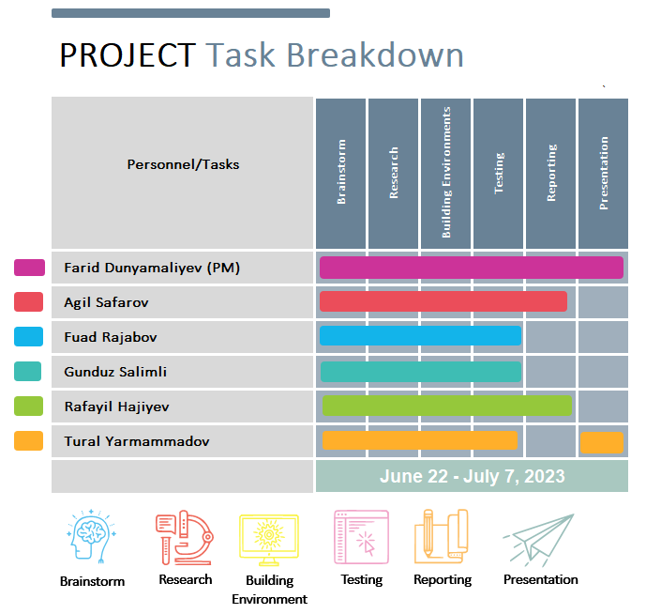
Notes:
We made an effort to involve all team members in the Splunk activity, recognizing its importance, as we hadn't previously had the opportunity to work with Splunk. This allowed us to gain valuable hands-on experience and maximize our understanding of Splunk's capabilities for detecting and mitigating brute force attacks in the AD DS environment.

Slide 26
SUMMARY
Overview of the project setup, including the deployment of AD DS, SIEM, and targeted servers.
Configuration of Splunk to effectively detect and respond to brute force attacks.
Live demo showcasing the detection of brute force attacks and the generation of alerts using Splunk.
Mitigation and response strategies, emphasizing the importance of immediate action, incident response planning, continuous monitoring, and education.
Benefits of using Splunk for detecting and mitigating brute force attacks, including centralized visibility, real-time alerts, advanced analytics, and enhanced incident response capabilities.
Notes:
Summarize the key points covered in the presentation: Introduction to brute force attacks and their impact on security.
Overview of the project setup, including the deployment of AD DS, SIEM, and targeted servers.
Configuration of Splunk to effectively detect and respond to brute force attacks.
Live demo showcasing the detection of brute force attacks and the generation of alerts using Splunk.
Discussion on mitigation and response strategies, emphasizing the importance of immediate action, incident response planning, continuous monitoring, and education.
Benefits of using Splunk for detecting and mitigating brute force attacks, including centralized visibility, real-time alerts, advanced analytics, and enhanced incident response capabilities.

Slide 27

Thanks for your attention!!!

